Slide 1

Customer Churn Prediction
Under the guidance of Mr Rehan Guha with Packt and TeamEpic
Team Members :
Akash Jain
Vipin Singh
Vikas Singh
Prathamesh Jagtap

Slide 2
Outline
Business Problem
Problem Statement & Business Objectives
Dataset
Project Architecture
Technology Stack
EDA
Data Preparation
Data Modelling
Hyperparameter Tuning
Thresholding
Models Comparison
UI Development
Deployment
Business Recommendation
Future Scope

Slide 3
Business Problem
Customer churn is the loss of clients or customers. In simple words, it is the percentage of subscribers to a service who discontinue their subscriptions to the service within a given time period.
Predicting churn can help the Telecom company, so it can effectively focus a customer retention marketing program (e.g. a special offer). This might lead business owners to imply that in order to grow their customer base, the rate of acquiring new customers must exceed the churn rate.
Therefore, the “churn” column is chosen as target and the following predictive analysis is a supervised classification problem.

Slide 4
Problem Statement
Given one year of a customer’s telephonic data, we need to predict if the customer churns in the next month. It is a two-class classification problem. Therefore, the “churn” column is chosen as target and the following predictive analysis is a supervised classification problem.
Business Objectives and Constraints
The cost of misclassification can be very high.
No strict latency concerns.
Interpretability is important.

Slide 5
Dataset
The customer churn dataset is an open-source dataset that contains 20 features and 4250 observations. The feature ‘Churn’ shows customer churn or non-churn based on existing conditions.
Approximately 14.5% of the ‘Churn’ is ‘yes’ label, and 84.5% of ‘non-churn’ is ‘no’ label. In this experiment, 80% (3400 instances) and 20% (850 instances) of the dataset are used for training and test datasets, respectively.

Slide 6
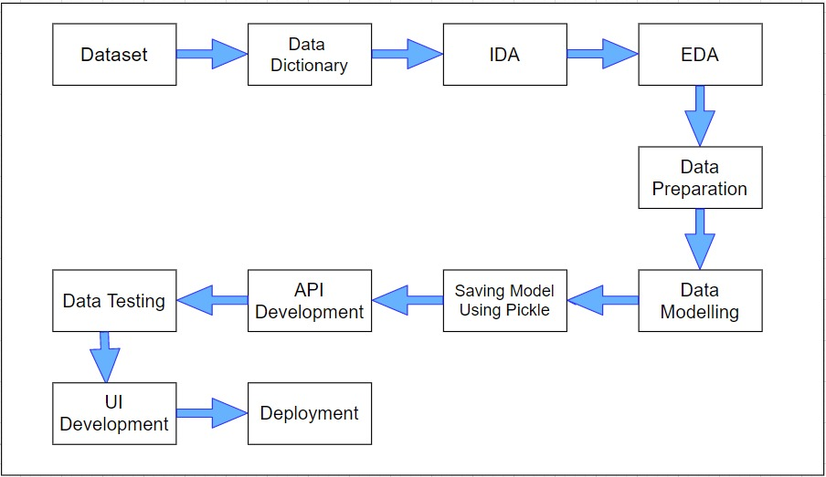
Project Architecture

Slide 7

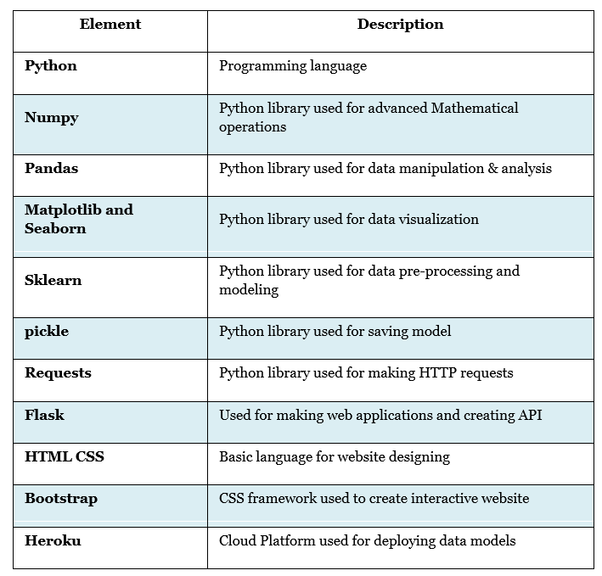




Technology Stack

Slide 8
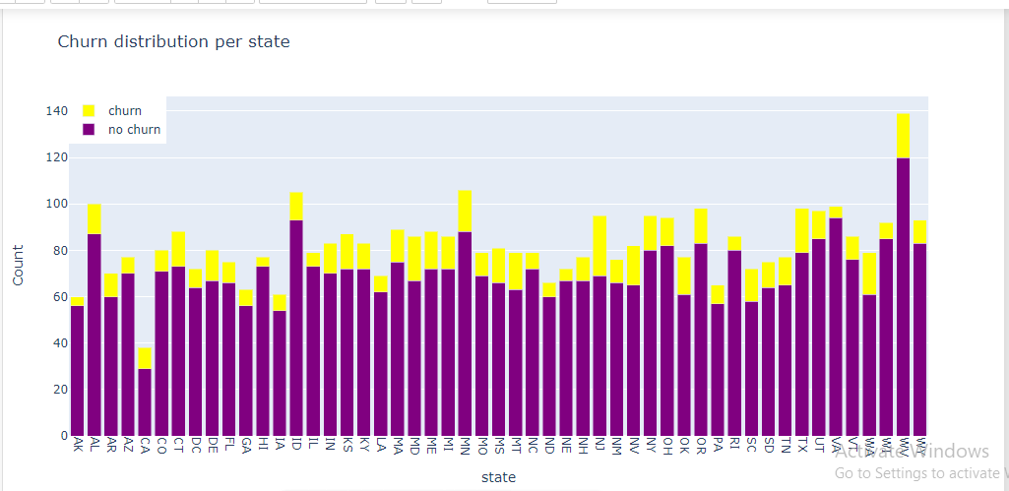
EDA
State Wise Churn Distribution
We can see that some states have less proportion of customer with churn like AK, HI, IA and some have a higher proportion such as WA, MD and NJ. This shows that we should incorporate the state into our further analysis, because it could be help to predict if a customer is going to churn.

Slide 9
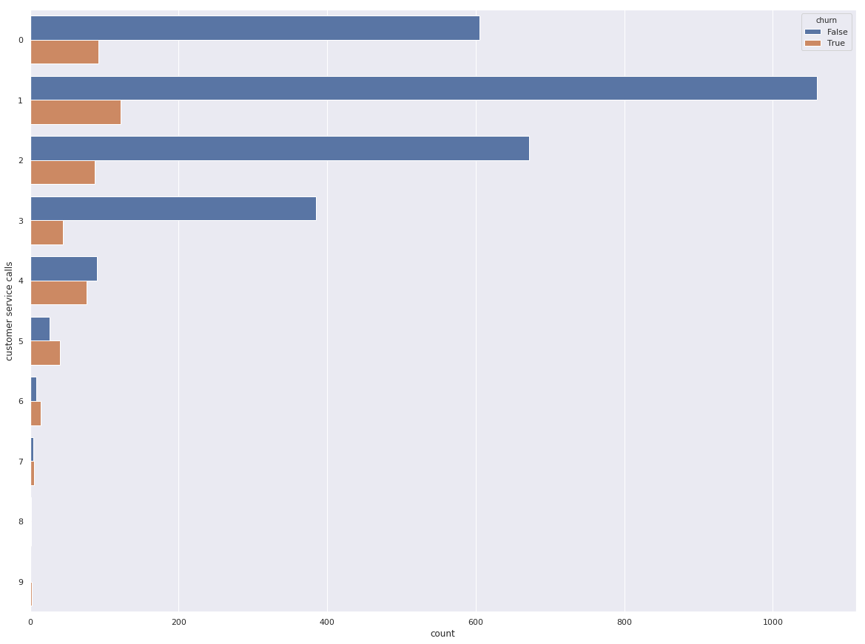
EDA
Customer Service Calls
The link between churn and the number of calls is definitely present (very low p-value), though weak. The connection is direct. That is, the more the customer calls the support service, the more likely they are to leave the company. Starting somewhere from the 5th call, the likelihood that he will leave the company exceeds the probability that he will remain

Slide 10
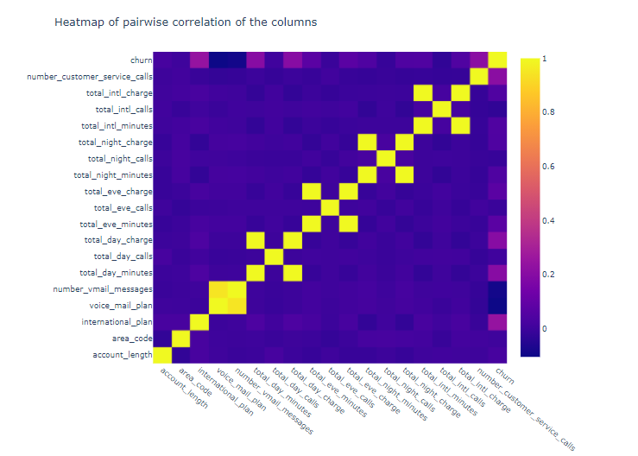
EDA
Heatmap
We can see a high correlation between the voice mail plan and the number of voice mail messages. It makes sense that customers with the voice mail plan also send more voice mail messages.
However, the international plan is just slightly correlated with the total international minutes and the international charge.
The greatest correlation is observed between the variables' total day minutes' and 'total day charge', 'total eve minutes' and' total eve charge ',' total night minutes' and 'total night charge'. These connections are obvious, since the cost directly depends on the duration of the call.

Slide 11
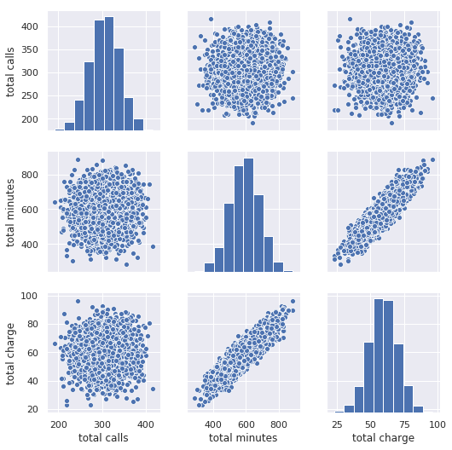

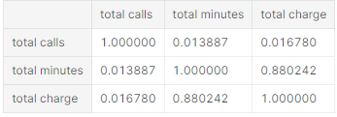
EDA
Let's consider the relationship between the total duration of calls, the amount and the duration. Below are the Spearman correlation values
As expected, the relationship between 'total minutes' and 'total charge' is quite high.

Slide 12
Data Preparation
Load the dataset onto Jupyter IDE and import all necessary libraries that will be needed for analysis.
Performed initial analysis, checking the format and type of the various numerical and categorical columns.
Encoding the categorical variables with different encoding techniques which included Label Encoding and Category encoding.
Handling missing values with statistical method approach. Here, all the numerical missing values were handled through median of each feature rather than taking mean as there were outliers.

Slide 13
Data Preparation
Likewise, all the categorical missing values were handled by replacing it with the most frequent occurrence value of that feature.
As there were some outliers in our data, we tried to first identify the outliers through the 1.5 IQR rule. By doing this, we found that there were some outliers which were again handled through the median technique for each column.
Reduced the functional/business sense of each of those columns, their relevance in predicting the business solution and form initial hypothesis of the most critical features which could be crucial in designing the model.

Slide 14
Data Modelling
For data modelling we choose 3 classification models Logistic Regression, Random Forest and SVM.
A pipeline structure is created consisting of Filling null values, Scaling data using Standard Scaler, Performing PCA on the data along with models Logistic Regression, Random Forest and SVM.
We created a pipeline for each given model and tries to fit it with training data and testing it on test data. Then we tries to evaluate these models using evaluation metrics such as confusion matrix and classification report , accuracy and roc curve.

Slide 15
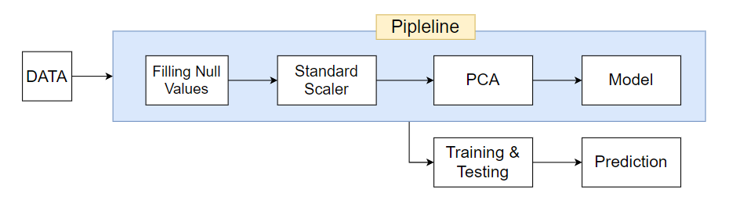
Model Pipeline

Slide 16
Hyperparameter Tuning
Hyperparameter tuning is choosing a set of optimal parameters for a model that allows the model to maximize its performance.
GridSearchCV method for hyperparameter tuning uses a different combination of all the specified hyperparameters and their values and calculates the performance for each combination and selects the best value for the hyperparameters.
We will do hyperparameter tuning with GridSearchCV method for each model pipeline and tries to fit it with training data and testing it on test data
and do evaluation of these hypertuned models.

Slide 17
Thresholding
Threshold is basically a cut-off value which decides the class label based on prediction probability values for each class. The default value for the threshold is 0.5. If value of prediction probability is less than 0.5 then it classifies as class 0 and if greater than 0.5 then it classifies as class 1.
For our models, the value of false positive is very high for each model so to decrease this false positive value to some extent, we found out optimal threshold using precision recall curve for each model and then test and evaluate each model to find out best model for our final prediction.

Slide 18
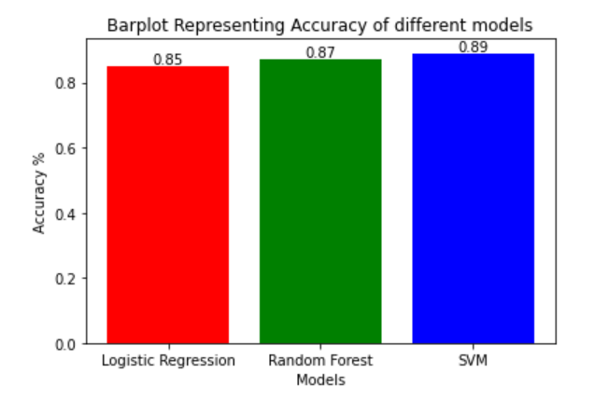
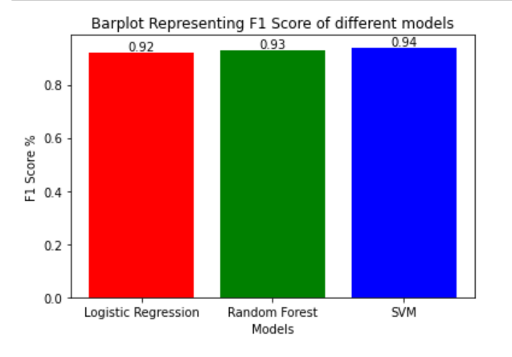
Models Comparison
Accuracy is used when the True Positives and True negatives are more important while F1-score is used when the False Negatives and False Positives are crucial. Accuracy can be used when the class distribution is similar while F1-score is a better metric when there are imbalanced classes as in the above case. As we can see above by accuracy and F1 score, SVM is best model for prediction.

Slide 19
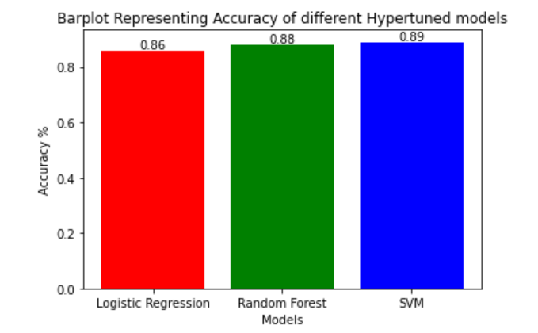
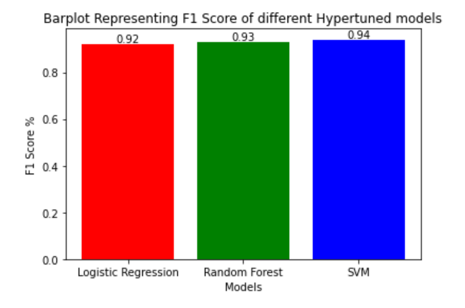
Models Comparison
After hyper tuning the models
As we can see above after tuning the model with optimal parameters we get SVM as our best model. Basically we simply build a model for each possible combination of all of the hyper parameter values we get, evaluating each model, and selecting the architecture which produces the best results.

Slide 20
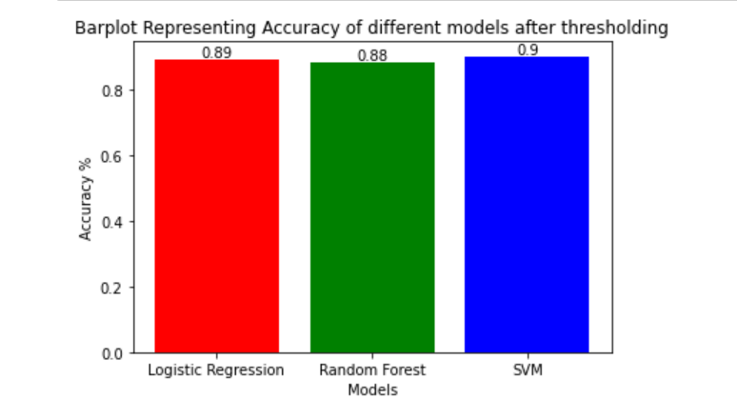
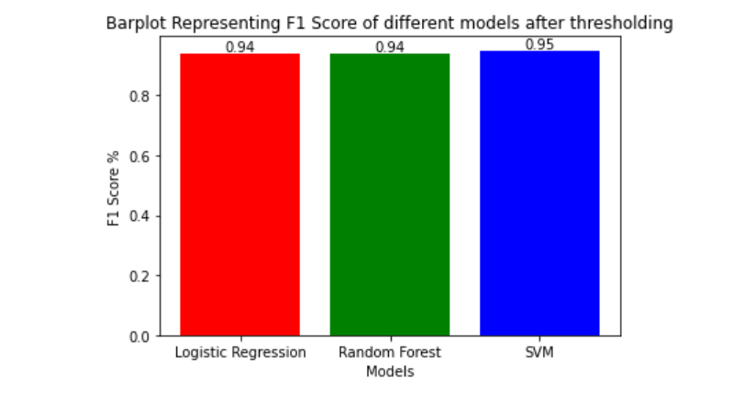
Models Comparison
Tuning with optimum threshold value
A value above that threshold indicates "churn"; a value below indicates "not churn." Here after tuning thresholds, we get 0.4143 best threshold value with F-Score: 0.5851. By threshold, we can minimize the chance of making a mistake. For example, mistakenly labeling a non-Churn customer as Churn is very bad. However, mistakenly labeling a Churn customer as non-Churn is unpleasant, but hardly the end of your job. After tuning our models with best threshold we get SVM as best model for prediction.

Slide 21
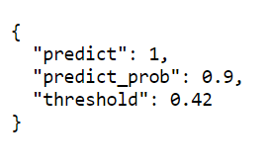
UI Development
In front-end we have created a website with the help of HTML, CSS and bootstrap framework. There are 2 ways user can input the data i.e. single input and batch input.
In Back-end, we have used Flask framework to build web-application. It fetches the data from our python(.py) file to website.
There is a button provided for prediction of new data, by clicking on it user will automatically get the desired output .
As a result of our prediction, user will get a report of churn value, churn probability & their probability threshold in json format. Output for single input is given below.

Slide 22
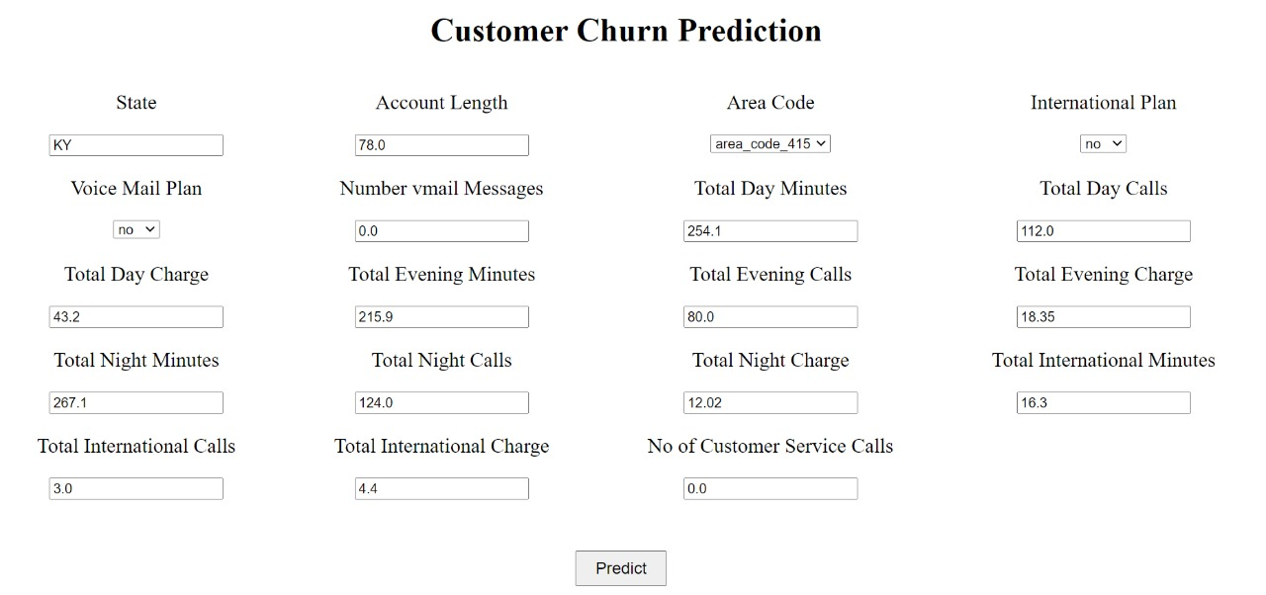
Heroku Deployment
We have created a wire-frame design using the Heroku. It is a container-based cloud Platform as a Service (PaaS). Our platform is elegant, flexible, and easy to use, offering developers the simplest path to getting their desired predictions.
Address : https://customer-churn-prediction-v2.herokuapp.com/
Snapshot for single input.

Slide 23
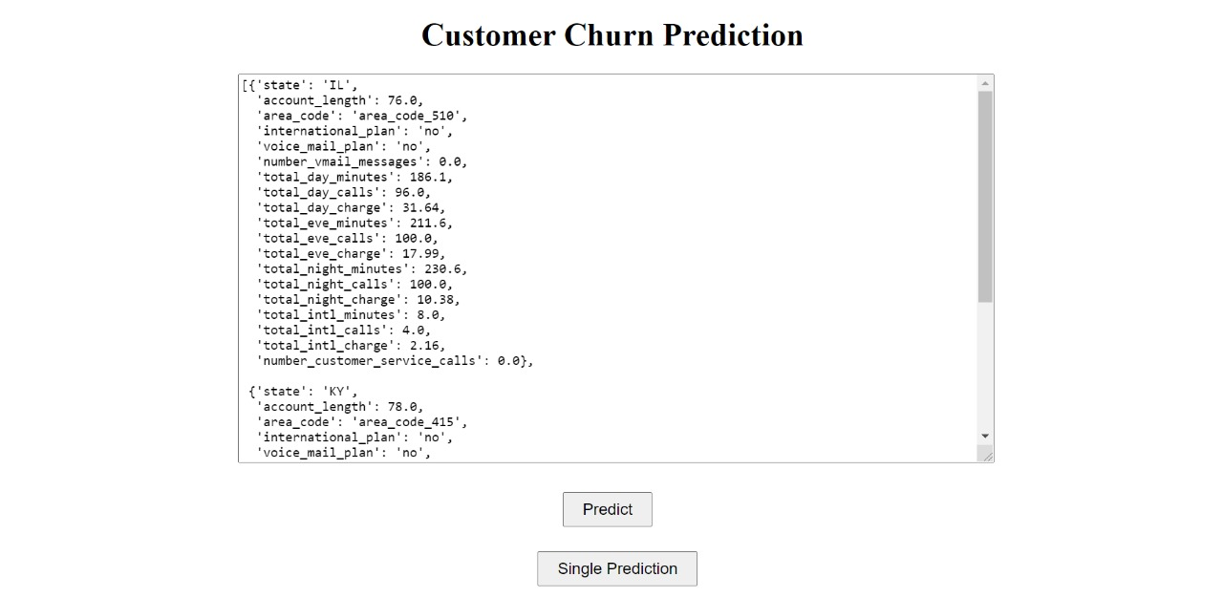
Heroku Deployment
Snapshot of Deployed model for batch as an input through dictionary format.

Slide 24
Business Recommendations
We found that the accuracy achieved with SVM is far much higher than the Logistic regression and Random Forest technique which clearly states that SVM is an efficient technique. No algorithm will predict churn with 100% accuracy as we have seen similar accuracy with logistic regression and random forest. This actually means most of the variance in the data is explained.
This predictive model is given that classifies customers based on their probability of churn and their activities. We can use this model to prioritize whose concerns to be addressed first.
Take the following actions immediately:
Enterprises need to implement customized win-back strategies according to the specific needs of customers.
The scientific approach to allow high-value customers to get more attention, reduce the input for low-value customers, and maintain different “values” for customers with different values

Slide 25

Future Scope
The operating data from only one telecom operator are taken into account in the project, the selection of data is limited to some extent, so the future scope may consider cross-platform data to improve the comprehensiveness and externality of model project.
Also, in telecom enterprises, customer churn is a long-term behavior, but the raw data is measured in month for customer churn prediction, and the continuity of data selection is not sufficient, so the time interval of subsequent model building can be extended.

Slide 26

Learning's
It was fun and meaningful doing this small project. Made us understand what more we need to work on. In the process we learnt,
Data Science Process
To Apply Machine Learning basics studied in courses and text books.
Metrics to measure the goodness of the model. Learnt that accuracy is definitely not a good enough measure in case of imbalanced classes. class weight argument works magically by penalizing the mistakes in minority class more!
Thanks for taking time to go through this project. Feedback is highly appreciated.

